Slide 1
Events All The Way Down: Event Sourcing vs EDAs
Comparing two common event-based patterns

Slide 2
Agenda
What’s an Event?
What’s an Event-Driven Architecture (“EDA”)?
What’s Event-Sourcing?
Compare EDAs with Event Sourcing
Can they play nice together?

Slide 3
What’s an Event?
A birthday?
A tech conference?
The signing of a treaty?
YES TO ALL!
It’s history! Something that happened!

Slide 4
What’s an Event?
From the excellent Journey to Event Driven blog series by Confluent (makers of Kafka):
In the real world, the nature of the “event” can be described as:
Atomic: something happened (bid on an item, send an email, device temperature)
Related: a stream or sequence of events (tracking a pricing change, device metrics changing over time)
Behavioral: the accumulation of facts captures behavior

Slide 5
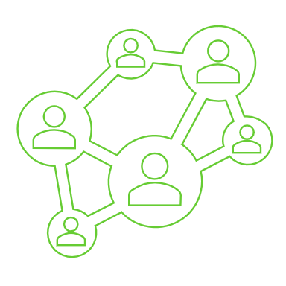
What’s an Event-Driven Architecture?
Enterprise communication pattern
Apps publish events as business activities are performed
Events ideally represent business activities, not data changes or snapshots
Interested apps can subscribe and react to those events
Archive of business activity history
Ex: Ring says “person at door” twice around 9pm: Kids took the trash out
Ex: PA for MRI with a PA for a cognition eval may imply Alzheimer’s
Ex: Large volume of PAs for pain killers may signal fraud

Slide 6
What’s an Event-Driven Architecture?
Microservice-friendly
Choreography, not orchestration
Services determine for themselves when they will act
Distributes and encapsulates trigger logic with code
Resilient
Communicating via events instead of API calls is asynchronous
Failures of upstream systems don’t cause downstream failure
Data simply grows stale until upstream comes back online

Slide 7
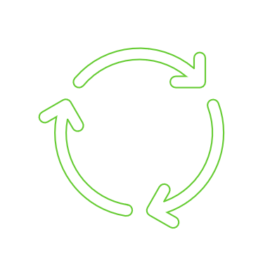
What’s Event-Sourcing?
Two-layer service pattern for enforcing business rules
The first layer validates incoming commands and responds synchronously
Protects data integrity with immediate feedback to the caller of violations
Answers questions about the current state of entities
The second layer generates events that are past-tense versions of the commands. These events are…
…published to the environment at-large for interested consumers
…replayed by the first layer to calculate current entity state

Slide 8
What’s Event-Sourcing?
Two-layer service pattern for enforcing business rules
Layer 1: Command Processing
Protects data integrity with immediate validation feedback to the caller
Answers questions about the current state of entities
Key point: L1 responds synchronously
Layer 2: Event Processing
L2 generates events that are past-tense versions of the commands
L2 publishes these events for interested consumers
L2 handless storage of events (append and load only!)
L2 contains the event “handlers” called by L1 to replay state

Slide 9
What’s Event-Sourcing?
Events are tailored toward advancing entity state on replay
Makes “rewinding” entity state to a point in time easy
When entities have complex lifespans, caching of state snapshots can be done
Some event-sourced services also store a “projection” (think “materialized view” or “read-optimized store”) of each entity’s current state
Mixes real-time validation with history-sourced (“event-sourced”) state

Slide 10
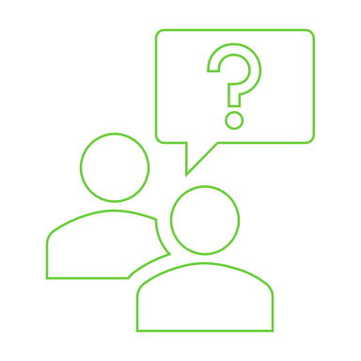
Compare EDAs with Event-Sourcing
Similarities
Events are central to both patterns
Both patterns have similar criteria for what makes a “good” event
However, there’s more variation in events between and among EDAs
Both support replay…but with different goals

Slide 11

Compare EDAs with Event-Sourcing
Differences
Purpose
EDAs are a communication pattern that enable high availability and low coupling
Event Sourcing is used for data integrity for complex domains
Use of replay
EDAs: Replay supports building data stores – new ones, or rebuilding existing ones – based on business activity history
Event Sourcing: Replay is used to calculate current state every time, making entity state traceable and supporting corrective events

Slide 12
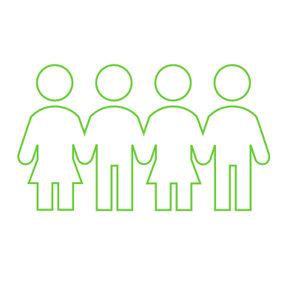
Can they play nice together?
Yes!
Event-sourced microservices are a natural fit in an EDA
Event sourcing generates events that are easily published in an EDA
There is very little overlap – neither can effectively achieve the aims of the other

Slide 13
Questions?

Slide 14

THANK YOU!
If you have any further questions, or just want to chat about event-first designs, feel free to reach out!
Phil Jerkins WebEx Teams - preferred!
Phil.Jerkins@eviCore.com Email
https://phil-jerkins.tiddlyhost.com/ Bio and CTC Notes
Follow Phil at CTC2022!

